Slide 1
Intro to: GPIO Comms
Communicating with Components and Communication Protocols

Slide 2
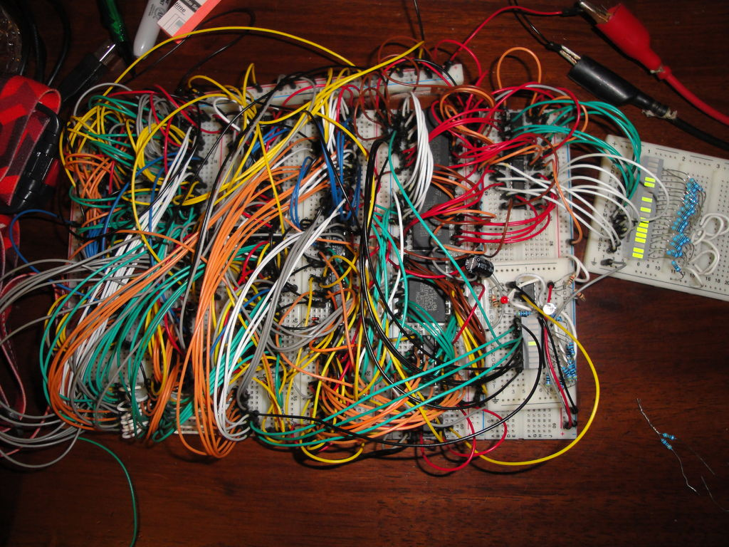
Introduction
GPIO: General Purpose Input Output
Signal vs. Data Transmission
GPIO signals
High and Low
PWM
I2C
SPI
UART

Slide 3


Communication With Components
The processor needs send signals to components and receive data from them.
010101011 0010011001 1010111000
CPU/Controller
Component
Notes:
At it core robotics is about building systems composed of controllers and modules such as sensors and motors. Central to this concept is the communication between components. At the machine level this communication is accomplished with bit streams. Bit streams move on output stream of one component to an input stream of another. The instructions we encapsulate in programming is compiled down into 1s and 0s so it can be transmitted by modulating the frequency of electrical pulses.

Slide 4
So Many Components
How do we talk to multiple components?
How do we listen to multiple components?
inputs
output
220897
778354
What’s your number?
55707
762343
782343
Controller
Modules
Notes:
But how do we write programs to talk to those components to get them to perform tasks and/or read the data they send back to the controller/CPU. We need to identify the components we want to send specific commands to and we need to be able to identify the data from specific components. There are a couple solutions to this problems.

Slide 5




Solution One
Use a dedicated line.
input
output
782343
What’s your number
Controller
Modules
Notes:
The first solution is to have a direct wire to the component. This way we don’t need to ask which component is on the other end or identify who is sending the signal. We simply use the line to send a command in our program. The lines are attached to input or output pins which carry the signal to or from components.

Slide 6
Solution Two
Identify who you are talking to!
output
input
Fred
Hey Fred: What’s your number
782343
Controller
Modules
Notes:
The second solution is to use an identifier such as an address or an identifier signal to specify which component we want to talk to. Conceptually, all components can hear the instructions but only the component we identify will listen and obey those instructions. So how does all this work? What’s the difference between solution one and two. Why do we use one solution and not the other? Well, we have a limited number of input/output pins on a Raspberry Pi, so we can only connect a limited number of components. The strategies differ the most by where the bus that directs the signals is located, either on the micro-controller (or computer) or on the component itself.

Slide 7
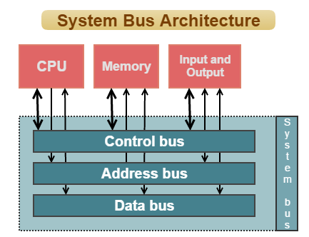
Computer Buses
A communication system that directs and transfers data between computer components.
The electrically conducting path along which data is transmitted.
Addressing protocols:
Defines I/O addresses
Directs signals to components
Notes:
Think of a computer bus like a traffic director for electrical signals. Sometimes we lose sight that at the machine level all programs have to activate mechanisms. A bus is a systems directs and switches the electrically conducting paths along which data is transmitted. A bus takes in an address and sends the signal to the target component.

Slide 8
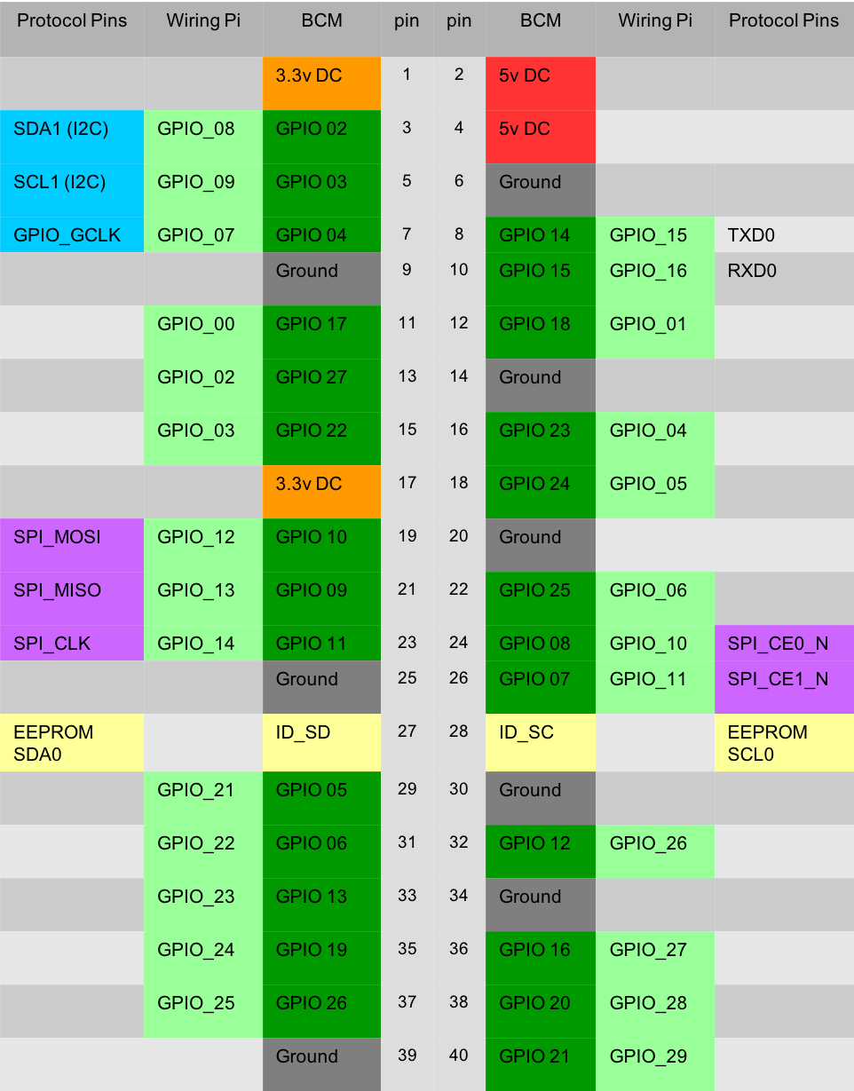
GPIO Pins
GPIO = General Purpose Input/Output (26 pins)
Each Pin has an address:
e.g.: 0x7E20 0064
Pin Maps:
GPIO.BCM (Braodcom SOC Channels)
GPIO.Borad (Pin Numbers)
WiringPi
10 Pins alternative functions
Notes:
The Raspberry Pi has 26 General Purpose Input/Output Pins, 10 of which have alternative functions. Each Pin has an address. There are several Pin Mapping systems that makes it easier to access these pins in programs. The board pin mapping allows you to access various pins by their position on the Raspberry Pi starting from the left pin furthest from the the ethernet and usb ports, left to right down to the right pin closest to the ethernet and usb ports. BCM uses the Broadcom SOC channel numbers. WiringPi addressing was programmed to provide a standard set of mappings and functions for multiple languages. Pins with alternative functions include pins capable of ustilizing I2C, SPI, and UART protocols.

Slide 9
Basic Communication
Turn Pin On --> HIGH --> 5 volts
Turn Pin Off --> Low --> 0 Volts
HIGH
Low
Notes:
At the most basic level of all computing is an electrical signal that can only do two things, turn on and turn off. This is the foundation of a digital signal. In computing terms a HIGH signal is on and a LOW signal is off, normally applying 5v or 3.3v electrical current to a wire, fiberoptic, or copper/aluminum trace on a microchip.

Slide 10
GPIO example in Python
GPIO.setup(5, GPIO.OUT)
GPIO.output(5, GPIO.LOW)
sleep(30)
GPIO.output(5, GPIO.HIGH)
sleep(50)
GPIO.output(5, GPIO.LOW)
HIGH
1
Low
0
30 ms
50 ms
Notes:
The Raspberry Pi pins can be easily set up and used. Simply provision a specific pin as an input or output pin. Then you can set them as high or low. In the example on this slide, GPIO pin 5 is set to output, it is then turn off and the program waits (or sleep3) for 30 milliseconds. Then it turns on and waits for 50 milliseconds before turning off again.

Slide 11
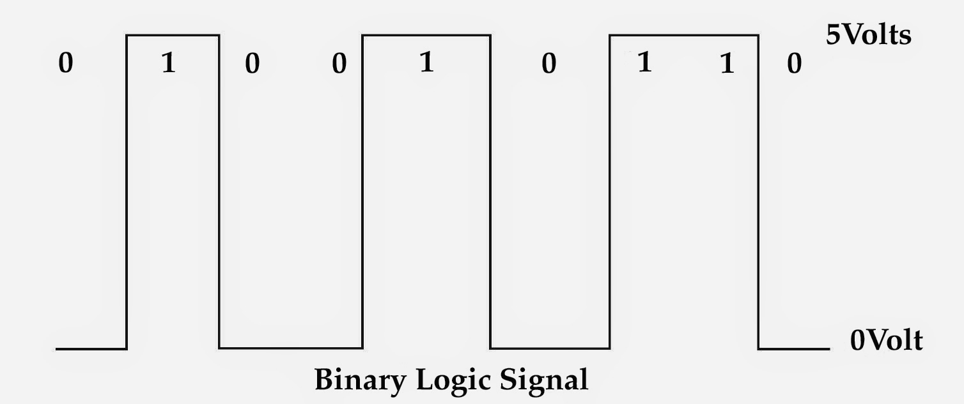
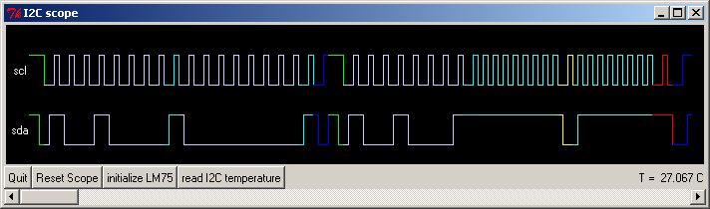
Digital Signals
Bit Streams are streams of 1s and 0s
5 Volts = 1
0 Volt = 0
Can use these 5 volt signals to send data over bit streams.
These streams can be used for communication between components and controllers
Notes:
Since these signals have two states: HIGH and LOW, they are easily used to send digital communications. When a pin is set to HIGH (5 volts) it translates into a 1 and when the pin is set to LOW (0 volt) it translates to a 0. Therefore, by turning the pin on and off very quickly you can send a bit stream that is received as binary code. These streams can do more then turn components on and off, they can send data, transmitting complex communications.

Slide 12
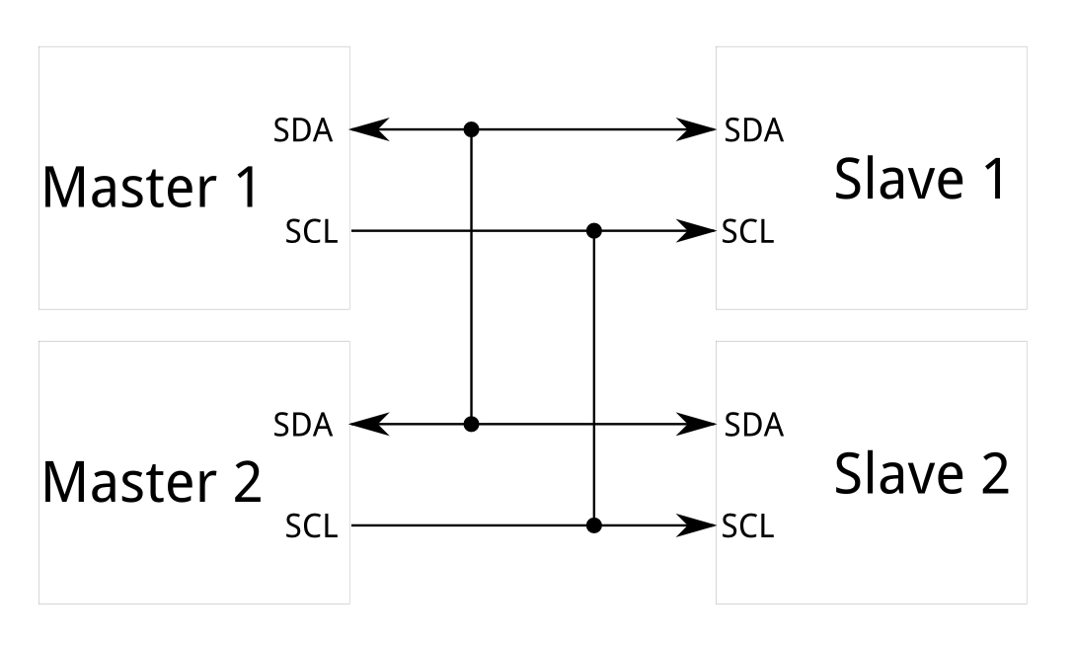
Communication Protocols I2C
I2C: Inter-Integrated Circuit
Multi-Master, Multi-Slave, Packet Switched, Single Ended, Serial Computer Bus
SDA: serial data pin
SCL: serial clock pin
Sends a data packet
Notes:
Since you can send complex communications, you can transmit an address of a target component and send complex instructions. I2C is a multi-master, multi-slave, serial communication. It uses two pins, the SDA is the serial data pin and pin #3 on the Raspberry Pi. This pin sends the data streams. The second pin is the SCL or serial clock pin and pin #5 on the Raspberry Pi. The serial clock synchronizes the master and the slave. When the SDA sends a data packet it sends the address of the component that should receive it.

Slide 13
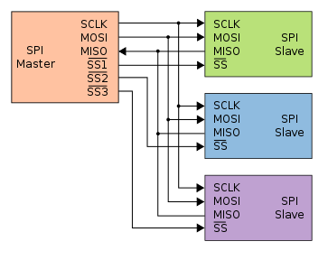
Communication Protocols SPI
SPI: Serial Peripheral Interface
Single Master, Multi-Slave, Full Duplex, Serial Computer Bus
MOSI: Master Out, Slave In
MISO: Master In, Slave Out
SLCK: Serial Clock
SS: Slave Select
Simultaneous Communications
Notes:
The Serial Peripheral Interface is a single master, multi-slave full duplex, serial bus. It has separate lines for the master (MOSI) and slave (MISO) to send data. Therefore, both can send data at the same time. A third pin, the slave select (SS) pin, is used to identify the component component that should listen to the communication. All components are connected to the same MOSI and MISO wires and receive the bitstream, but only the components whose SS is set to HIGH will listen and obey the instructions sent in the bitstream. Each additional component on the SPI protocol requires only one more pin for the SS. SPI also uses a serial clock pin (SCLK) to synchronize all the components.

Slide 14
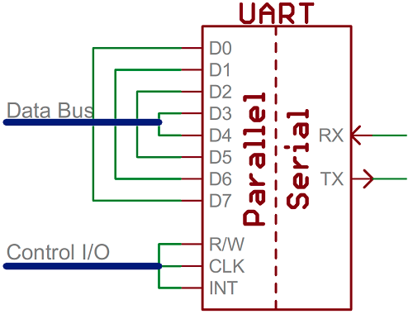
Communication Protocols UART
UART: Universal Asynchronous Rx/Tx
A Receiver-Transmitter protocol that uses a bus to go between parallel and serial communication.
Notes:
The Universal Asynchronous Receive Transmit protocol does not use a serial clock and only requires two pins for communication. Like other protocols, it has a header in its data packets that identifies the component it is sending the packet to. The UART protocol converts parallel communications with multiple components into serial communication to send data back and forth.

Slide 15
Conclusion
We can write programs to control external components like sensors and motors.
Buses and addressing allow us to direct communications to the right place.
Data can be sent between controllers and components with bit streams.

Slide 16
Questions

